Slide 1
9.5 Feature scaling via PCA sphering

Slide 2
In the [Section 9.3] we saw how feature scaling via standard normalization significantly improves the topology of a machine learning cost function.
This enables much more rapid minimization via first order methods like e.g., the generic gradient descent algorithm.
In this Section we describe how PCA is used to perform a more advanced form of standard normalization - commonly called PCA sphereing (also commonly referred to as whitening).

Slide 3
With this improvement on standard normalization we use PCA to rotate the mean-centered dataset so that its largest orthogonal directions of variance align with the coordinate axes prior to scaling each input by its standard deviation.
This typically allows us to better compactify the data, resulting in a cost function whose contours are even more 'circular' than that provided by standard normalization and thus makes cost functions even easier to optimize.

Slide 4
The PCA sphering scheme

Slide 5
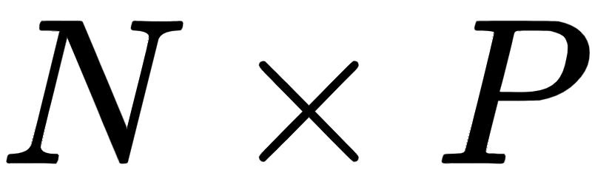

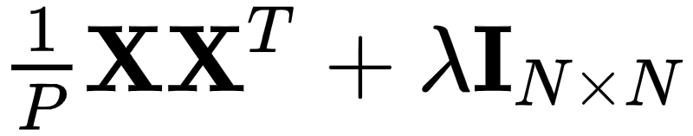

Before discussing PCA-sphereing, let us recall a few key notations and ideas from our discussion of PCA itself (see Section 8.3).
Stacking our input data together column-wise we create our data matrix .
We then denote the regularized covariance matrix of this data
And its eigenvalue/vector decomposition.

Slide 6
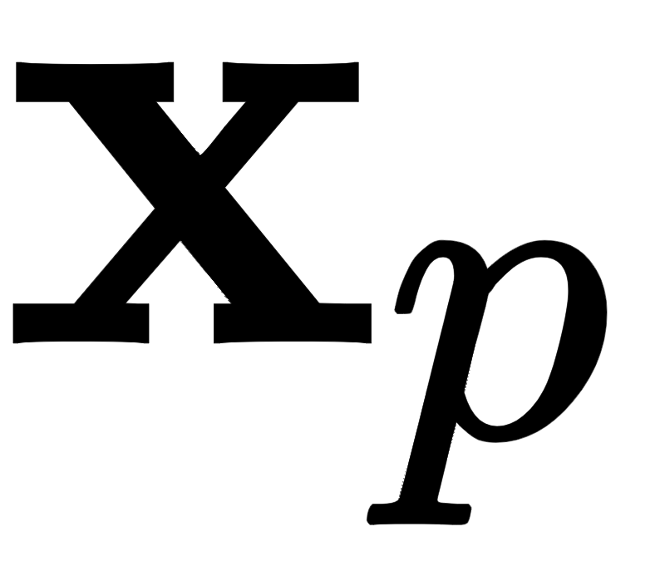
Also recall that when performing PCA we first mean-center our dataset.
We then aim to represent each of our mean-centered datapoints
datapoint .
In the space spanned by the principal components we can represent the entire set of transformed mean-centered data as

Slide 7

Remember that this PCA transformation rotates the mean-centered data so that its largest orthogonal directions of variance align with the coordinate axes of the input space.
"PCA-sphereing" takes this process one step further.
To sphere the data we simply divide off the standard deviation along each coordinate of the PCA-transformed (mean-centered) data

Slide 8
PCA-sphereing is simply the standard normalization with a step inserted in between mean centering and the dividing off of standard deviations.
In between these two steps we rotate the data using PCA.
By rotating the data prior to scaling we can typically shrink the space consumed by the data considerably more than standard normalization.
This simultaneously makes the associated cost function considerably more "circular" and much easier minimize properly.

Slide 9
In the Figure below we show a generic comparison of how standard normalization and PCA sphereing affect a prototypical dataset, and its associated cost function.
Because PCA sphereing first rotates the data prior to scaling it typically results in more compact transformed data, and a transformed cost function with more 'circular' contours.

Slide 10
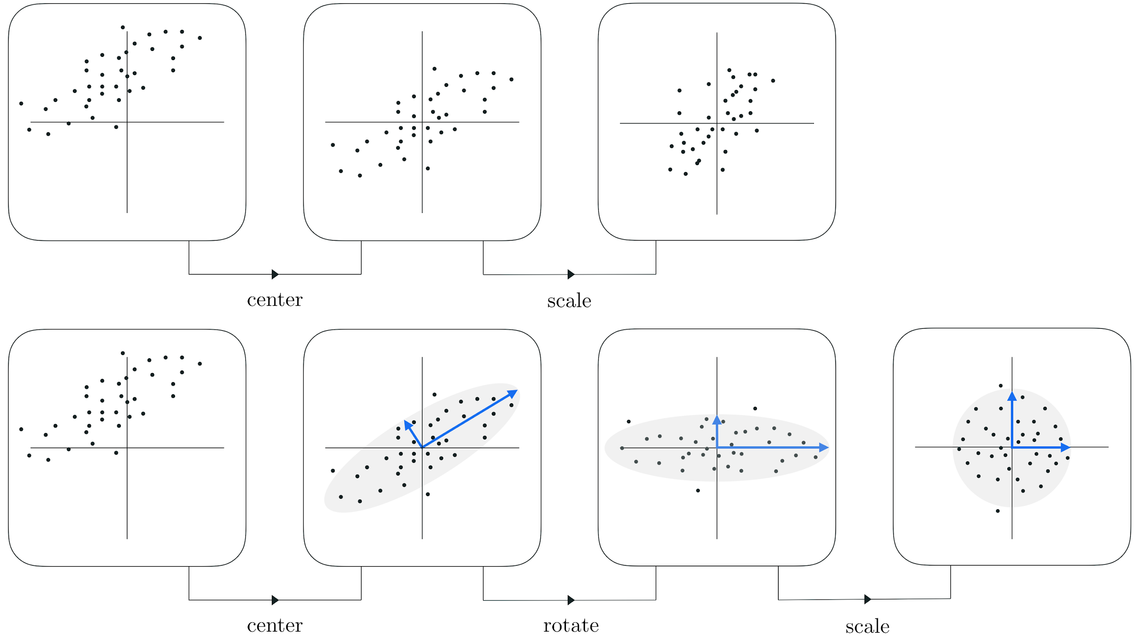
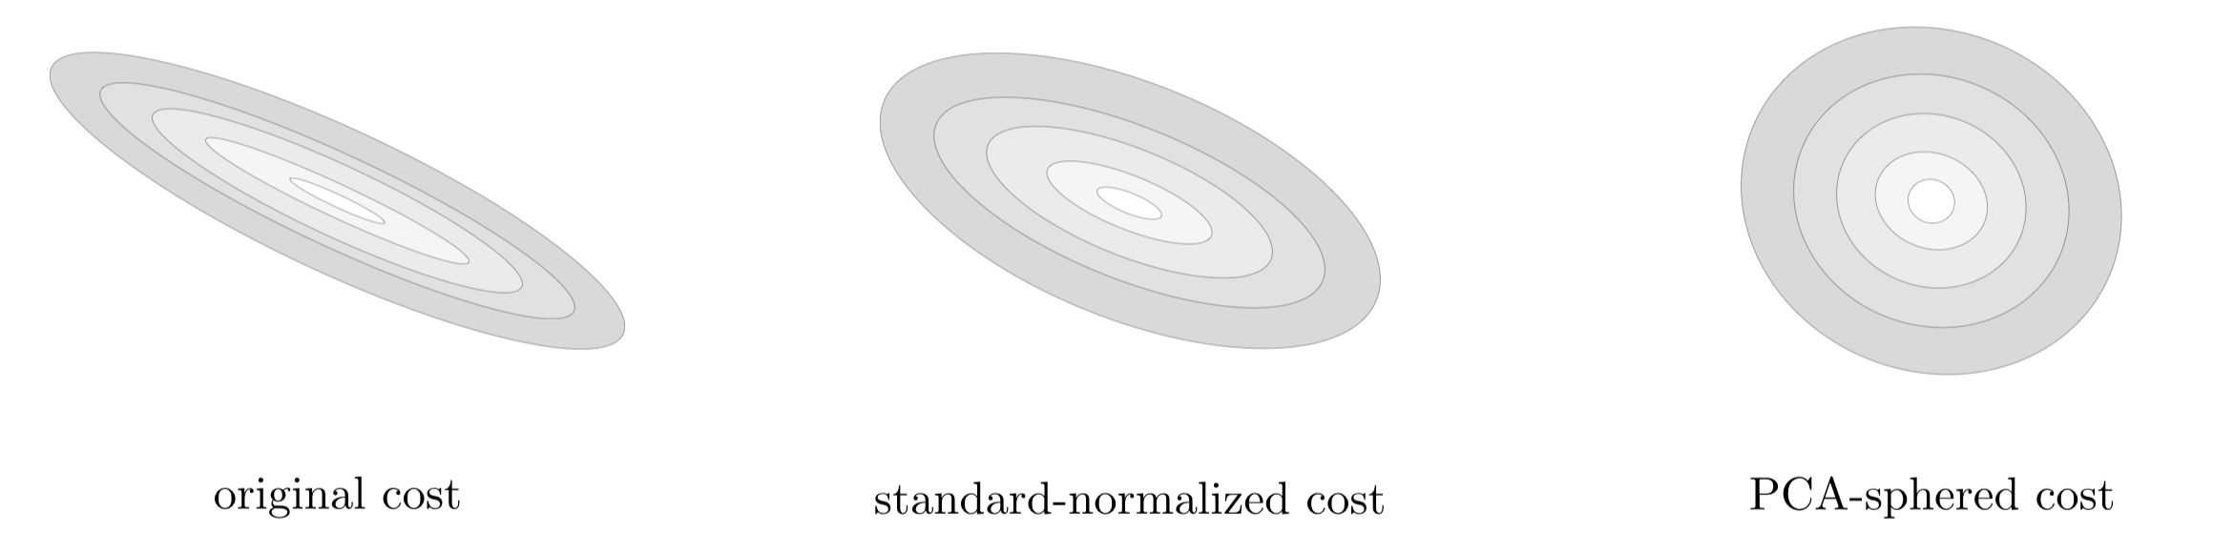

Slide 11
Formally if the standard normalization scheme applied to a single datapoint can be written in two steps as...

Slide 12
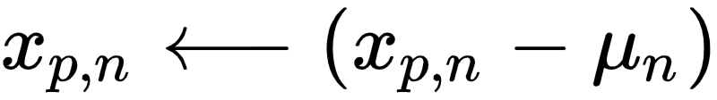
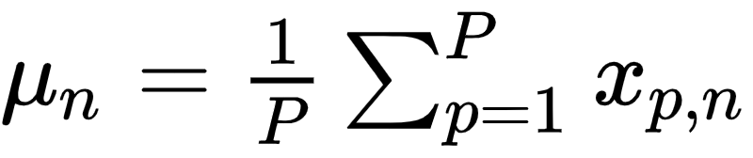
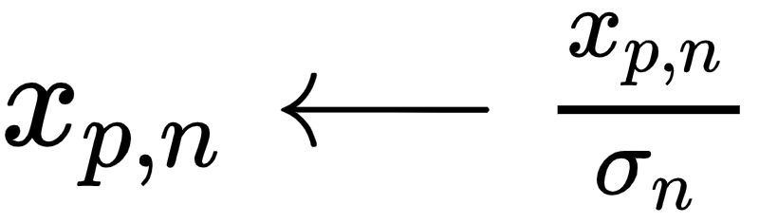
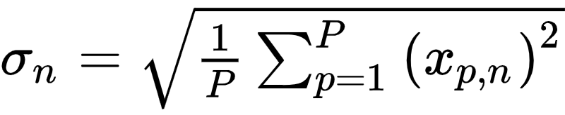
Standard normalization scheme:
1. (mean center) for each n replace where
2. (divide off std) for each n replace where

Slide 13
... then PCA-sphereing scheme can be then be written in three highly related steps as follows

Slide 14
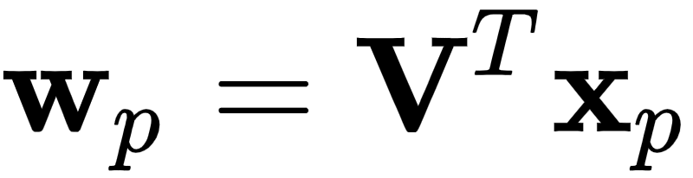
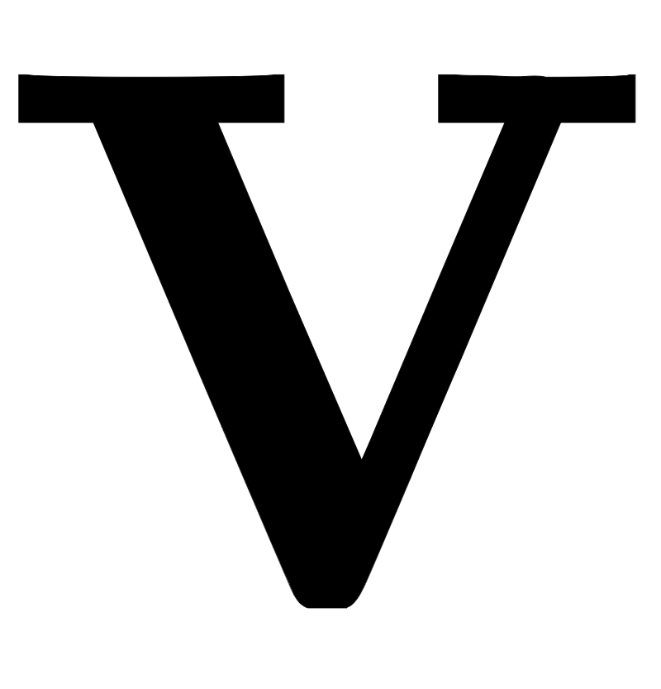
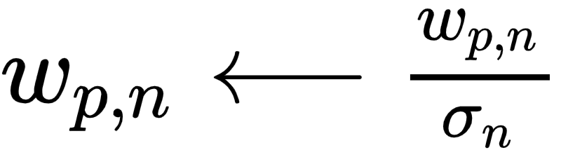
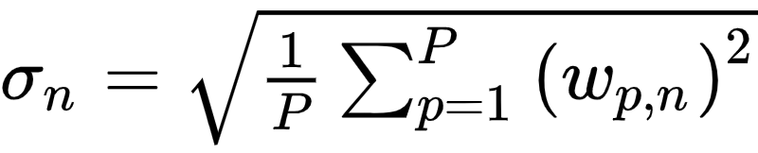
PCA-sphereing scheme:
1. (mean center) for each n replace where
2. (PCA rotation) transform where is the full set of eigenvectors of the regularized covariance matrix
3. (divide off std) for each n replace where

Slide 15
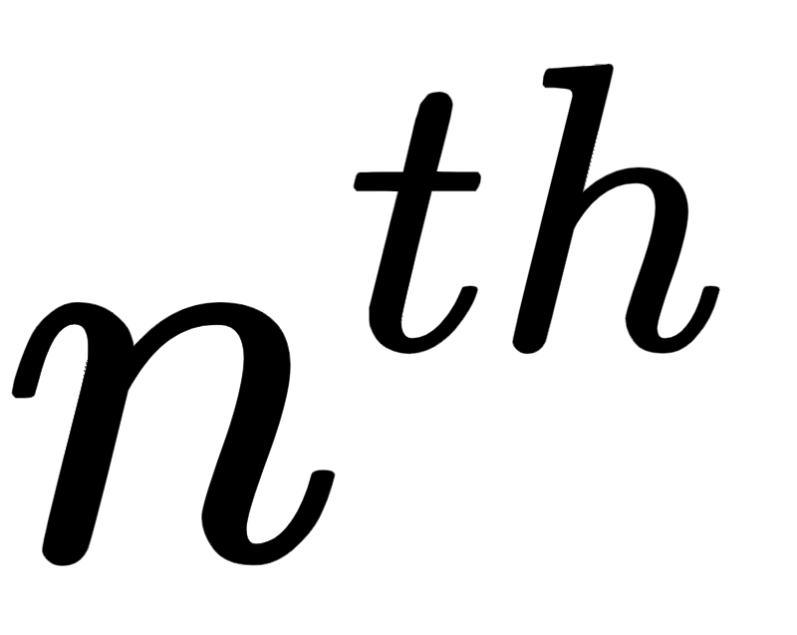
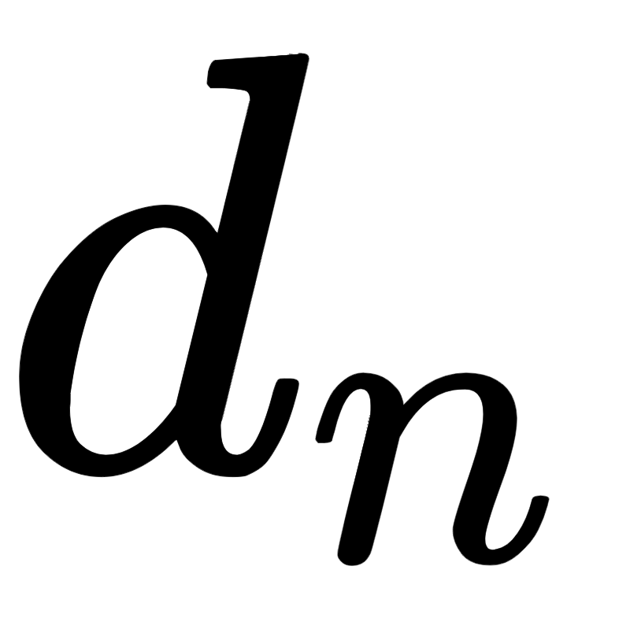
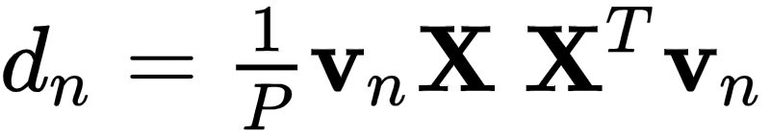
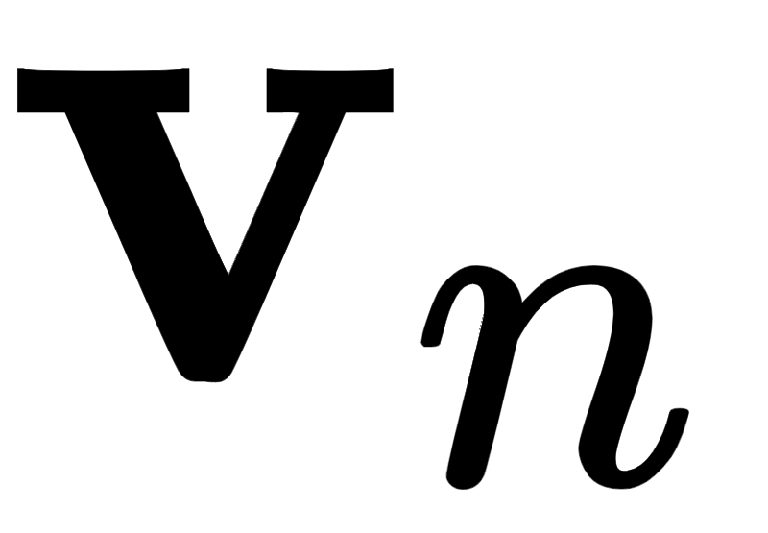
We can express step 3 of PCA-sphereing more efficiently using the eigenvalues of the regularized covariance matrix.
The Raleigh quotient definition of the eigenvalue of this matrix states that numerically speaking
Here is the and corresponding eigenvector.

Slide 16

In terms of our PCA transformed data this is equivalently written as
In other words the eigenvalue is the variance along the axis of the PCA-transformed data.
Since the final step of PCA-sphereing has us divide off the standard deviation along each axis of the transformed data we can then write it equivalently in terms of the eigenvalues as

Slide 17
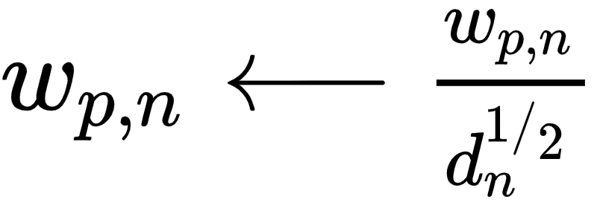
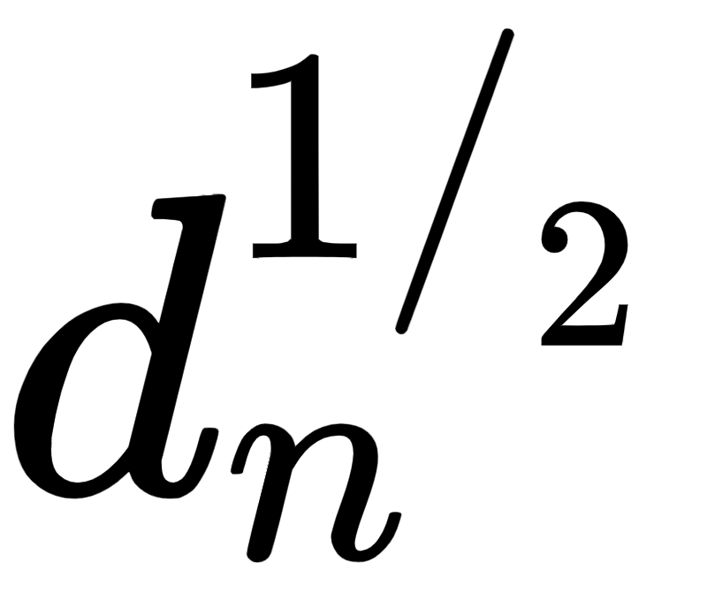
PCA-sphereing scheme:
1. (mean center) for each n replace where
2. (PCA rotation) transform where is the full set of eigenvectors of the regularized covariance matrix
3. (divide off std) for each n replace where is the square root of the eigenvalue of the regularized covariance matrix
---

Slide 18
While expressing PCA-sphereing in may seem largely cosmetic, it is indeed computationally advantageous to simply use the eigenvalues in step 3 of the method...
...instead of re-computing the standard deviations along each transformed input axis) since we compute them anyway in performing PCA in step 2.

